Slide 1


Slide 2


Slide 3


Slide 4


Slide 5


Slide 6


Slide 7


Slide 8


Slide 9
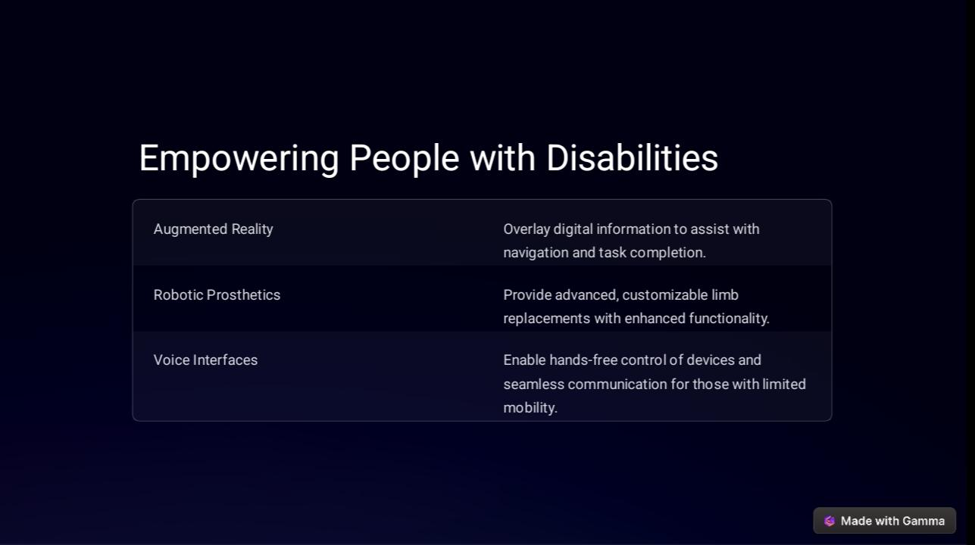

Slide 10
Group member’s
Kirbe Dedicatoria Taguba
Diana Tierro Limon
Jasel Aquileña Alariao
Legna Eam Gammag Odagal
Lovely Daluddung Quimma
Mikaela Nicole Danao
Patricia Tierro
Roselyn Dumaual

